Slide 1


Information Security: Cryptography
Lecture 2
DR. Muhammad Umar Aftab

Slide 2

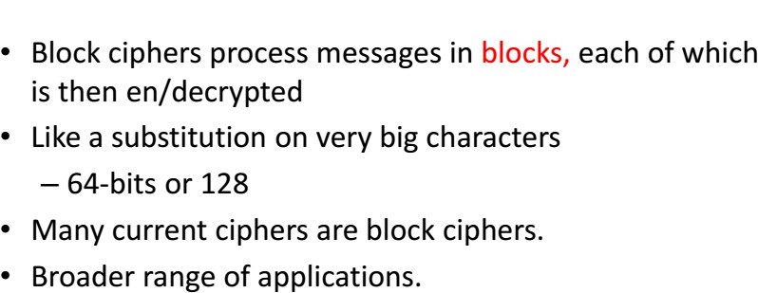
Block Ciphers

Slide 3
SYMMETRIC BLOCK ENCRYPTION ALGORITHMS
A block cipher processes the plaintext input in fixed- size blocks and produces a block of cipher text of equal size for each plaintext block.
DES
Triple DES
AES etc.,

Slide 4
DATA ENCRYPTION STANDARD
The Data Encryption Standard (DES) was designed by IBM.
Block Cipher
DES , adopted in 1977 by National Bureau of Standards(NBS), now National institute of Standards and Technology(NIST) as Federal information processing standard 46.
It was unbroken for more than 10 years since its publication and some aspects of its design were kept secret by IBM at the request of the US National Security Agency (NSA); some people believed that IBM and NSA had hidden a trapdoor in DES that only they knew about (that they could use to crack DES)

Slide 5
DATA ENCRYPTION STANDARD
Block Cipher
Block size – 64 bits
Follows Feistel Structure
Total Rounds – 16
Key Size – 64 bits
Sub keys – 16
Sub key size – 48 bits
Cipher text – 64 bits

Slide 6
DES CRITICISM
Before adopting as standard ,intense criticism.
  First, Enormous reduction in the key.
Too short to withstand brute force attack.
  Second , internal structure S-boxes was classified.

Slide 7
DES WIDE USE
DES flourish in financial applications.
In 1994, NIST reaffirm to use it for more 5 years.
In 1999, NIST issue a new version of its standard triple DES.

Slide 8
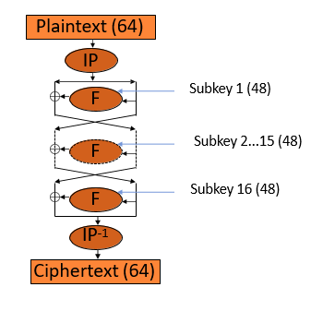
DES Block Cipher

Slide 9
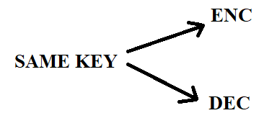
DES Introduction
DATA ENCRYPTION STANDARD (DES):
→ Symmetric Key-block cipher
→ Published by (NIST) National Institute of Standards and Technology.
→ DES is block cipher.

Slide 10
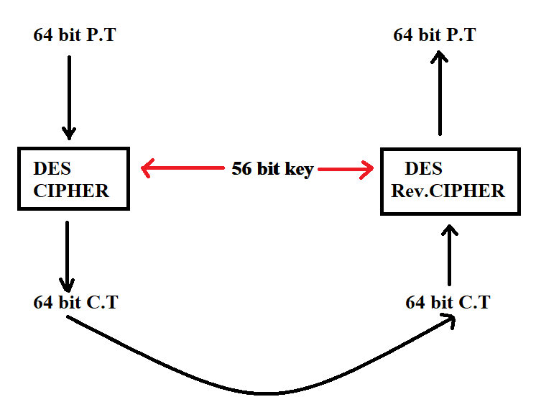
Overview of DES

Slide 11
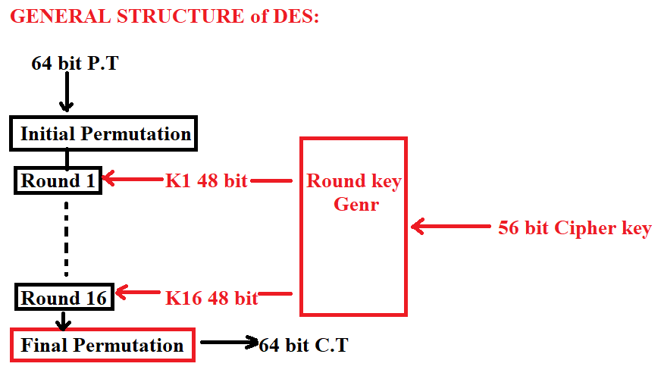
General Structure of DES

Slide 12
DES step 2
Initial Permutation (IP):
Occurs only once before the first round.
Final Permutation (FP):
Both initial and final permutation are straight P-Boxes that are inverses of each other. They have no cryptographic significance in DES. (Predefined)

Slide 13
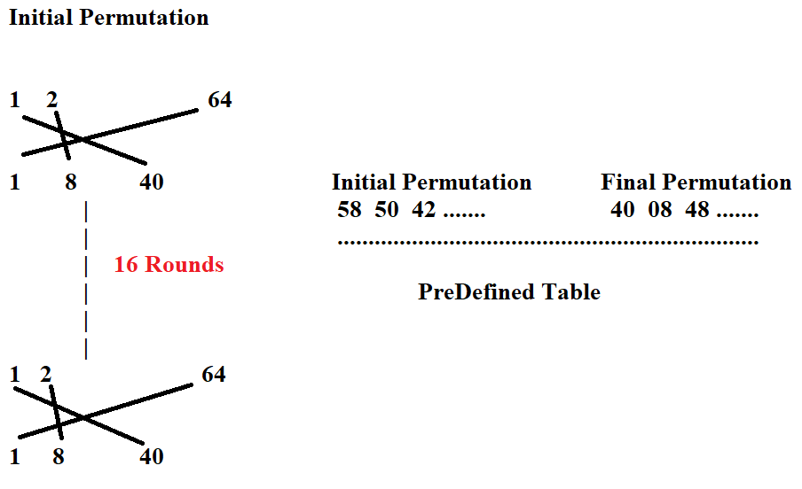
Permutation's concept

Slide 14
DES Step-3
ROUNDS:
There are 16 rounds, and each round is based on Feistel Cipher structure.
DES Function:
Applies 48 bit key to the rightmost 32-bit to produce 32-bit o/p.
→ Expansion P-Box
→ Whitener
→ Group of S-Boxes
→ Straight P Box

Slide 15
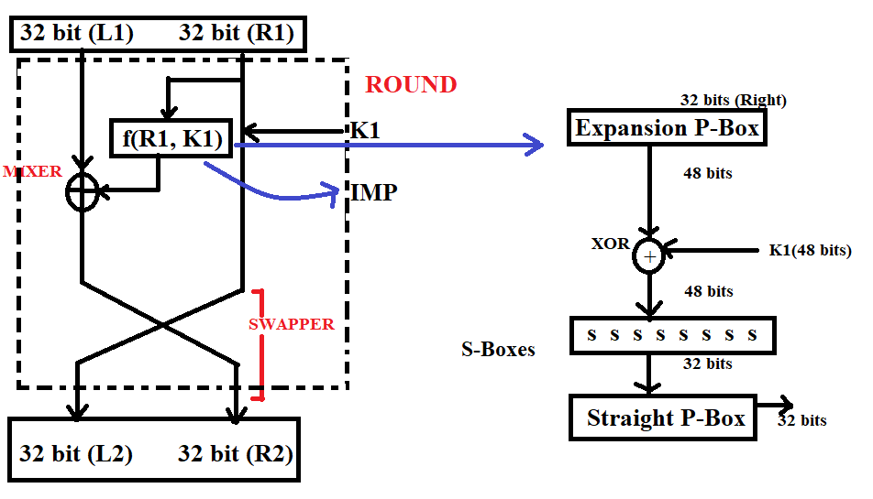
DES Step-3
Notes:
We can’t XOR 32 bit with 48 bits => so we need expansion box

Slide 16
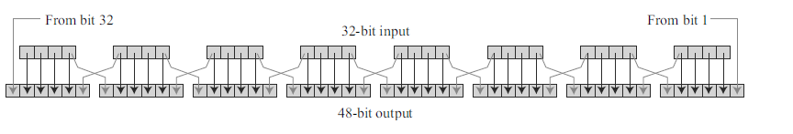
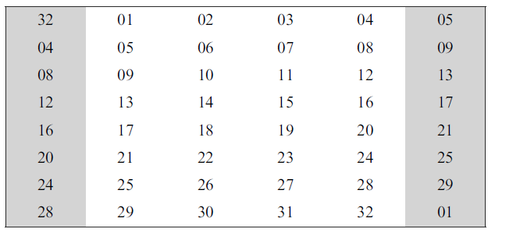
Expansion Box

Slide 17
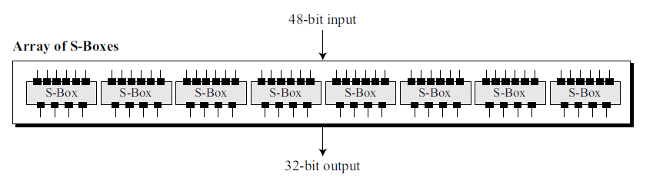
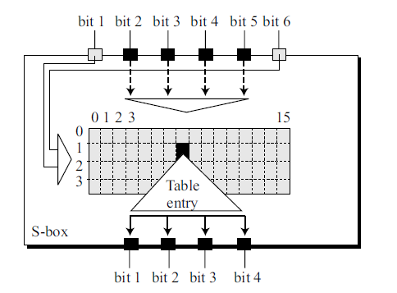
S Box

Slide 18
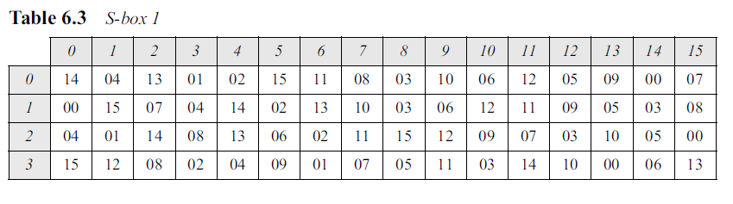
S Box
Example: The input to S-box 1 is 100011. What is the output?

Slide 19
S Box
Example: The input to S-box 1 is 100011. What is the output?
Output: If we write the first and the sixth bits together, we get 11 in binary, which is 3 in decimal. The
remaining bits are 0001 in binary, which is 1 in decimal. We look for the value in row 3, column 1, in Table 6.3 (S-box 1). The result is 12 in decimal, which in binary is 1100. So the input 100011
yields the output 1100.

Slide 20
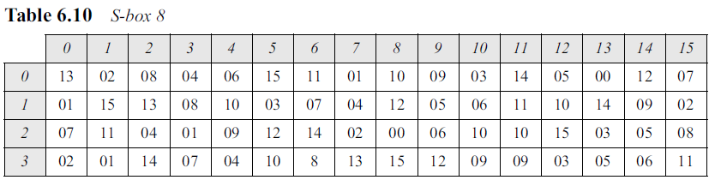
S Box
Example: The input to S-box 8 is 000000. What is the output?
Output: ???

Slide 21
S Box
Example: The input to S-box 8 is 000000. What is the output?
Output: If we write the first and the sixth bits together, we get 00 in binary, which is 0 in decimal. The remaining bits are 0000 in binary, which is 0 in decimal. We look for the value in row 0, column 0, in Table 6.10 (S-box 8). The result is 13 in decimal, which is 1101 in binary. So the input 000000 yields the output 1101.

Slide 22
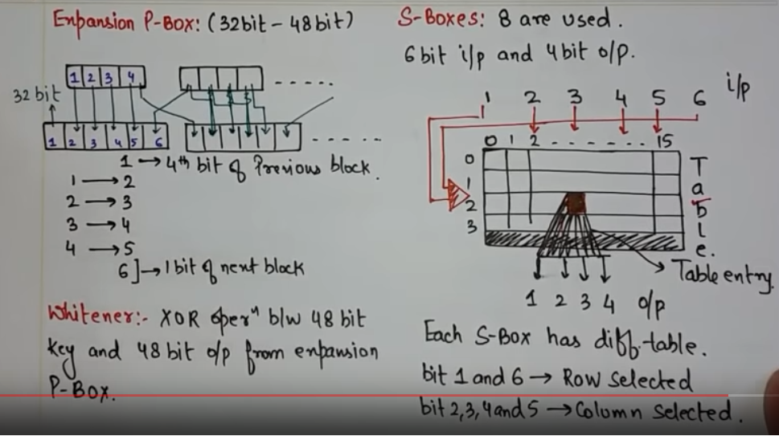
Des 4

Slide 23
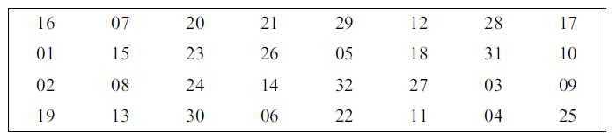
DES 4-1: Straight Permutations
32 bit output from S-Box as Input
32 bit output from straight Permutations

Slide 24
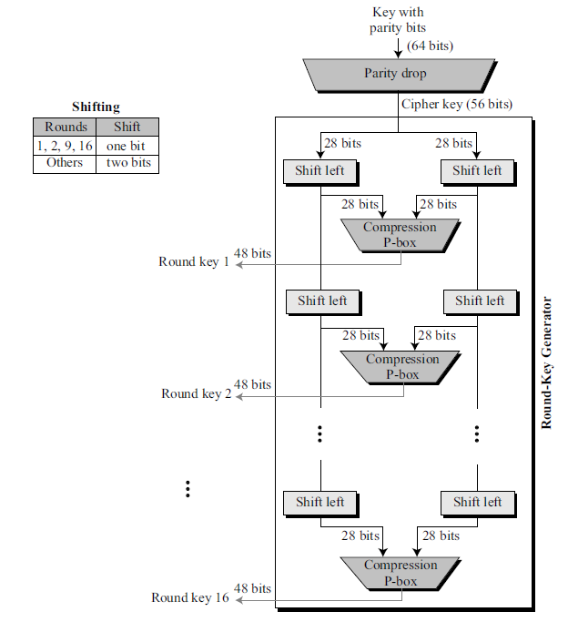
KEY GENERATION:
Round key-generator create sixteen 48-bit keys out of a 56-bit cipher key. Actual key is of 64 bit from which 8 extra parity bits are dropped.
Parity Drop→ (8, 16, 24, 32, 40, 48, 56, 64)
Shifting:
1, 2, 9, 16 → One bit
Others → Two bits.
Notes:
Suffle them=> place 28th bit one first place and move the rest bits one step ahead

Slide 25
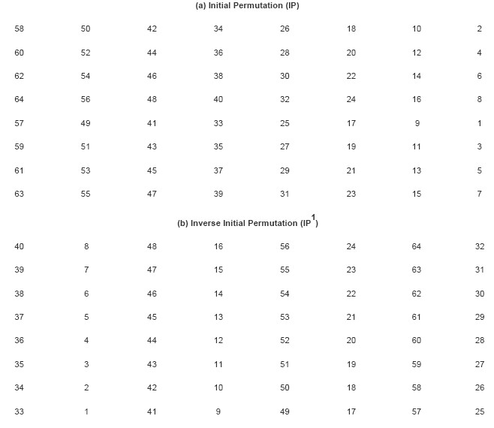
DES Block Cipher

Slide 26
DES Block Cipher
Notes:
Final Permutation

Slide 27
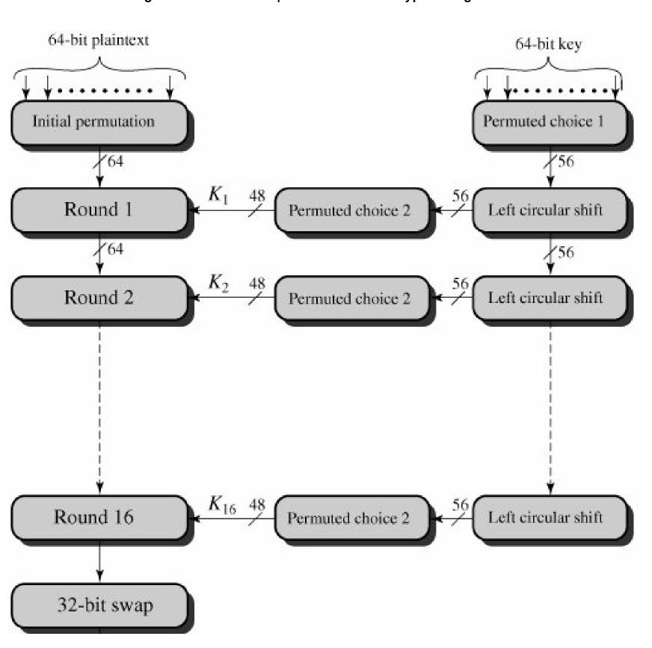
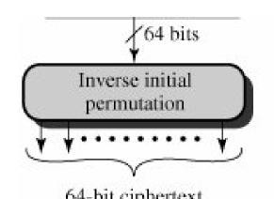
DES Block Cipher

Slide 28
DES Encryption (1/2)
There are two inputs to the encryption function: plaintext and key.
The plaintext must be 64 bit in length and the key is 56 bits in length*.
Left hand side of the figure, the processing of the plaintext proceeds in following phases.
First , the 64-bit plaintext passes through an initial permutation(IP) that rearrange the bits to produce permuted input.

Slide 29
DES Encryption (2/2)
This is followed by the phase of 16 rounds of the same function , involve substitution and permutation.
The output of the last(16th)round consists of 64-bits that are the function of input plaintext and the key.
The left and right halves of the output are swapped to produce the preoutput.
Finally , preoutput is passed through a permutation (IP⁻¹ ), to produce the 64-bit output.

Slide 30
DES Encryption (Key)
The right-hand portion, shows how 56-bit key is used.
Initially , the key is passed through a permutation function.
For each of the 16 rounds, a subkey (k _{i}) is produced by the combination of the left circular shift and the permutation. the permutation function is same for each round, but the different subkey is produced because of the repeated shifts of the key bits.

Slide 31
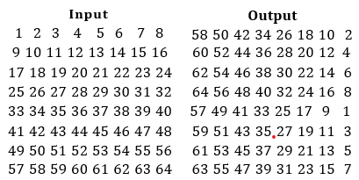
INITIAL PERMUTATION: IP(FROM LAST TABLES)
The 64-bit input data (message) block is first bitwise permutated (i.e., the bits within the block are rearranged)
This is done using the following permutation table:
Example: 35th bit of input block is equal to the 41st bit of the output block.

Slide 32
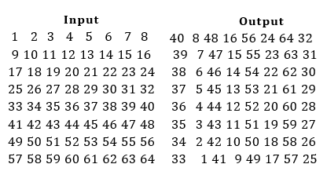
FINAL PERMUTATION
The 64-bit output after 16 rounds is finally bitwise permutated (i.e., the bits within the block are rearranged)
This is done using the following permutation table:
Example: 41st bit of Input block is equal to the 35th bit of the output block.

Slide 33
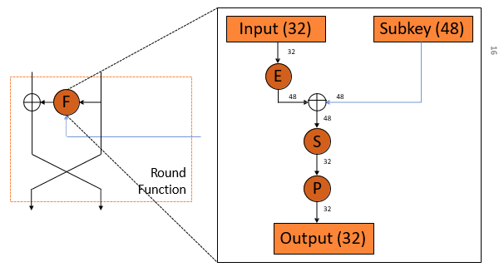
DES CIPHER FUNCTION

Slide 34
THE SINGLE ROUND
The left hand side of the diagram, the left and right halves of each 64-bit are treated as 32-bit quantities labelled as L(left) and R(right).
The round key K_{i} is 48 bit. The R input is 32 bits.
The R input is first expanded to 48 bits by using table that involves duplication of 16 of the R bits.
The resulting 48 bits are XORed with k_{i}.
This 48-bit result passes through a substitution function that produces a 32-bit output , which is permuted

Slide 35
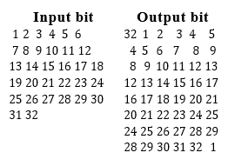
EXPANSION PERMUTATION: E(FROM LAST TABLE)
The expansion permutation acts on the 32-bit input to the cipher function.
It expands the 32-bit input block to a 48-bit output block by duplicating some input bits at specified positions
The permutation is given by the following table:
Example: 46th bit of output block (counting from left, starting from bit 1) is equal to the 31st bit of input block

Slide 36
EXPANSION PERMUTATION :E
32-bit data
48-bit expanded data

Slide 37
SUBSTITUTION BOXES: S
The substitution boxes (S-boxes) map a 6-bit input block to a 4-bit output block
There are 8 S-boxes, so the 48-bit input block is mapped to a 32-bit output block

Slide 38
SUBSTITUTION BOXES: S
S1
S2
S3
S4
S5
S6
S7
S8

Slide 39
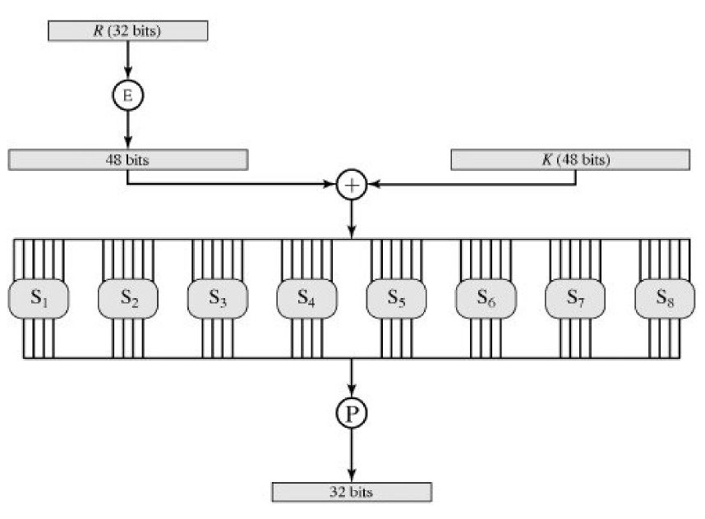
SUBSTITUTION BOXES: S

Slide 40
PERMUTATION: P
The 32-bit output of the S-boxes is then bitwise permutated (i.e., the bits within the block are rearranged)
This is done using the following permutation table:
Output | Input
1 2 3 4 | 16 7 20 21
5 6 7 8 | 29 12 28 17
9 10 11 12 | 1 15 23 26
13 14 15 16 | 5 18 31 10
17 18 19 20 | 2 8 24 14
21 22 23 24 | 32 27 3 9
25 26 27 28 | 19 13 30 6
29 30 31 32 | 22 11 4 25
Example: 25th bit of output block is equal to the 19th bit of the input block.

Slide 41
DES KEY SCHEDULE
The DES key schedule takes a 64-bit key and generates 16 48-bit subkeys, one per round
The key schedule uses two (fixed/known) permutation tables (called PC1 and PC2) and a table of “shifts” (called LS).

Slide 42
DES KEY SCHEDULE
The 64-bit key is used as input to the algorithm.
The key is first subjected to a permutation governed by the table labelled permuted choice one.
The resulting 56-bit key is then treated as two 28-bit quantities, labelled C₀ and D₀.
At each round, C_{i-1} and D_{i-1} are separately subjected to circular left shift or rotation , of 1 to 2 bits, these values serve as input to the next round.
They also serve as input to permutation Choice Two, which produce 48-bit output that serve as input to the function F(R_{i-1},K_{i}).

Slide 43
DES KEY SCHEDULE
Key (64)
PC1
Effective Key (56)
Round number = 1
Round number
LS LS
Round number
Is Round number = 16?
Yes
End
PC2
No
Increment round number
Subkey (48)

Slide 44
DES Decryption
The decryption uses the same algorithm as encryption , except the application of subkeys are reversed.

Slide 45
THE STRENGTH OF DES
The key length is 56 bits, there are 2⁵⁶ possible keys, 7.2 X 10 ¹⁶ keys, brute force attack impractical.
Assuming, on average half the key space has to be searched, a single machine performing on DES encryption per microsec would take more than 1000 years to break the cipher.
In 1977, Deffie Hallman, postulated that the technology existed to build a parallel machine with 1 million encryption devices, each of which could perform one encryption per microsec.
This would bring search time to about 10 hours , cost $20 million.

Slide 46
DES STRENGTH
DES finally proved insecure in July 1998,
When the Electronic Frontier Foundation(EFF) declared broken DES using “DES cracker”, cost $250,000 and publish the description of cracker , enables others to build their own, with decrease price of hardware and increase speed make DES worthless.

Slide 47
SUMMARY
Types of Cryptography
Asymmetric Key Cryptography
Symmetric Key Cryptography
  Requirements for secure symmetric encryption
  Approaches for attacking a symmetric encryption scheme
Block Ciphers vs. Stream Ciphers
Data Encryption Standard (DES)
  DES Encryption / Decryption
  Strength/Weakness of DES

